Slide 1

Department of Computer Science
University Institute of Engineering
DEPARTMENT OF COMPUTER SCIENCE & ENGINEERING
Bachelor of Engineering
Subject Name: System Programming
Subject Code: CST-315
Operating System
DISCOVER . LEARN . EMPOWER

Slide 2
Chapter-3.2 Operating System
Department of computer Science
Introduction to Booting
Dual Booting

Slide 3
Booting
When we start our Computer then there is an operation which is performed automatically by the Computer which is also called as Booting.
In the Booting, System will check all the hardware’s and Software’s those are installed or Attached with the System and this will also load all the Files those are needed for running a system.

Slide 4
Booting
In the Booting Process all the Files those are Stored into the ROM Chip will also be Loaded for Running the System.
In the Booting Process the System will read all the information from the Files those are Stored into the ROM Chip and the ROM chip will read all the instructions those are Stored into these Files.
After the Booting of the System this will automatically display all the information on the System.
The Instructions those are necessary to Start the System will be read at the Time of Booting.

Slide 5
Booting
After an operating system is generated, it must be available for the use by the hardware.
But how the hardware know where the kernel is, or how to load that kernel?
The procedure of starting a computer by loading the kernel is known as Booting the system.
Hence it needs a special program, stored in ROM to do this job known as the Bootstrap loader.

Slide 6
Booting
Booting is a startup sequence that starts the operating system of a computer when it is turned on.
A boot sequence is the initial set of operations that the computer performs when it is switched on.
Every computer has a boot sequence. Bootstrap loader locates the kernel, loads it into main memory and starts its execution.
In some systems, a simple bootstrap loader fetches a more complex boot program from disk, which in turn loads the kernel.

Slide 7
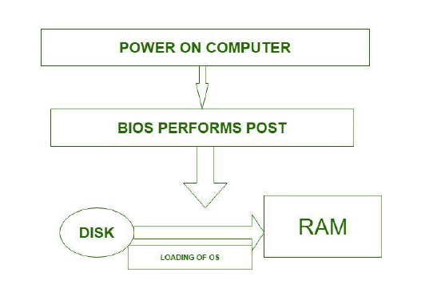
Booting

Slide 8
Dual Booting
When two operating system are installed on the computer system then it is called dual booting.
In fact multiple operating systems can be installed on such a system.
But how system knows which operating system is to boot?
A boot loader that understand multiple file systems and multiple operating system can occupy the boot space.

Slide 9
Dual Booting
Once loaded, it can boot one of the operating systems available on the disk.
The disk can have multiple partitions, each containing a different type of operating system.
When a computer system turn on, a boot manager program displays a menu, allowing user to choose the operating system to use.

Slide 10
Types of Booting
Warm Booting: when the System Starts from the Starting or from initial State Means when we Starts our System this is called as warm Booting.
In the Warm Booting the System will be Started from its beginning State means first of all, the user will press the Power Button, then this will read all the instructions from the ROM and the Operating System will be Automatically gets loaded into the System.

Slide 11
Types of Booting
Cold Booting: The Cold Booting is that in which System Automatically Starts when we are Running the System.
For Example due to Light Fluctuation the system will Automatically Restarts So that in this Chances Damaging of system are More.
The System will no be start from its initial State So May Some Files will b Damaged because they are not Properly Stored into the System.

Slide 12
References
Department of computer Science
Text Books:
Donovan J.J., Systems Programming, New York, Mc-Graw Hill,1972.
Dhamdhere, D.M., Introduction to Systems Software, Tata Mc-Graw Hill1996.
Reference Books:
Aho A.V. and J.D. Ullman Principles of compiler Design Addison Wesley/Narosa

Slide 13
THANK YOU

